Slide 1
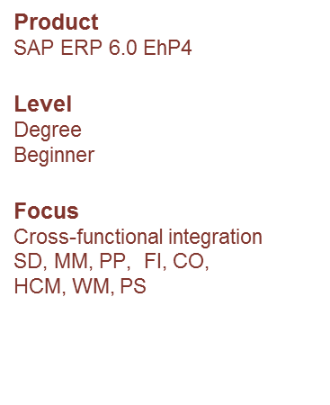
Production Planning and Execution (PP)
IBPSES
CT104-3-2-VD1
Prepared by: KN First Prepared on: 01.08.12 Last Modified on: DD.MM.YY
Quality checked by: xxx
Copyright 2012 Asia Pacific University of Technology and Innovation

Slide 2
Module Overview
PP Organizational Structure
PP Master Data
PP Processes
Material Planning
Production Planning
Manufacturing Execution Process

Slide 3
Overview
The production process consists of the various steps and activities involved with the manufacture or assembly of finished goods and semi finished goods.
SAP divides production into multiple processes
Production Planning
Manufacturing Execution
Discrete Manufacturing- products which are manufactured can be easily assembled and dis-assembled
Repetitive Manufacturing- Produced repeatedly over an extended period
Production – Process Industries
is the production of goods that are typically produced in bulk quantities
Design primarily for chemical, food and beverage industries along with batch-oriented electronics, paint.
Notes:
Repetitive- process manufacturing- powder, food, etc..

Slide 4
PP Organizational Structure
Client
An independent environment in the system
Company Code
Smallest org unit for which you can maintain a legal set of books
Plant
Operating area or branch within a company
Manufacturing, distribution, purchasing or maintenance facility
Storage Location
An organizational unit allowing differentiation between the various stocks of a material in a plant
Work Center Locations (production line)
- Location where work value added work needed to produce a material.
- It can be a machine or group of machine, work area, person/group of people who are responsible for completing operations.

Slide 5
GBI 2.0 Structure for Production Planning
Global Bike
Client
Global Bike Inc.
Global Bike Germany GmbH
Company
Code
Dallas
Heidelberg
Plant
Raw Materials
Raw Materials
Semi-fin. Goods
Semi-fin. Goods
Storage
Location
Finished Goods
Finished Goods
Miscellaneous
Miscellaneous
Assembly
Assembly
Packaging
Packaging
(Work Center Location)
Inspection
Inspection

Slide 6
PP Master Data
Material
Bill of Materials (BOM)
Routing
Work Center
Product Group

Slide 7
Bill of Materials (BOM)
List of components that make up a product or assembly
Wheel Assembly
Tire
Tube
Wheel
Hex nut
Lock Washer
Socket Head Bolt
Frame
Derailleur Gear Assembly
Seat Kit
Handle Bar
Pedal Assembly
Chain
Brake Kit
Warranty Document
Packaging
Notes:
Forecasting should be done primarily for end-item demand. In manufacturing situations, this means there is no real need for forecasting component parts which make up the final item. When production quantities for the end item have been determined, component demand can be computed based on the production plan of the end item and knowledge of the bill of materials (BOM).

Slide 8
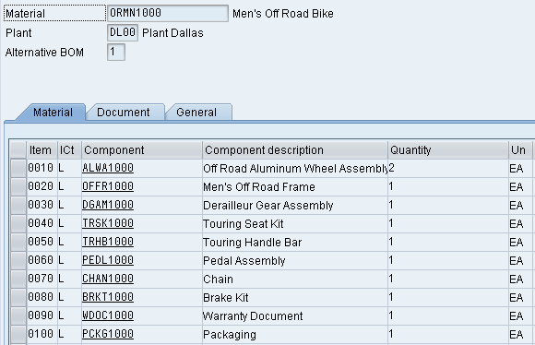
Bill of Materials (BOM)
Single-Level
Single-Level
Finished Bike
Wheel Assembly
Pedal Assembly
Frame
Chain
Derailleur Gear
Assembly
Brake Kit
Seat Kit
Warranty Doc.
Handle Bar
Packaging

Slide 9
Bill of Materials (BOM)
Single-Level vs. Multi-Level
Multi-Level
Single-Level
Finished Bike
Single-Level
Wheel
Frame
Derailleur
Seat
Handle Bar
Pedal
Chain
Brake
Doc.
Pack.
Tire
Tube
Wheel
Hex nut
Lock
Bolt

Slide 10
Bill of Materials (BOM)
Variant Bill of Materials (BOM)
Several products with a large proportion of identical parts.
Single-Level
Deluxe Bike (red)
Single-Level
Professional Bike (black)
Aluminum Wheel
Pedal Assembly
Carbon Wheel
Pedal Assembly
Frame red
Chain
Frame black
Chain
Derailleur Gear
Assembly
Brake Kit
Derailleur Gear
Assembly
Brake Kit
Seat Kit
Warranty Doc.
Seat Kit
Warranty Doc.
Handle Bar
Packaging
Handle Bar
Packaging
Notes:
Similar products: small variations
e.g. bike with a different color
If you are producing several similar products that have a lot of common parts, you can describe these products using a variant BOM. This is the case, for example, if you replace one material component with another to make a different product. Variants can also differ by containing different quantities of a component. You create the new BOM as a variant of an existing BOM.

Slide 11
BOM – Item Categories
Item Categories
Stock Item
Non-stock Item
Variable Material – Sheet of steel
Intra Item – Phantom material – process industry
Class Item – place holder
Document Item
Text Item
Notes:
Item Categories
Stock Item – place a reservation and removed from stock when needed
Non-Stock Item – Purchase Requisition will need to be created for the item
Document Item – CAD drawing, Engineering Documents, etc

Slide 12
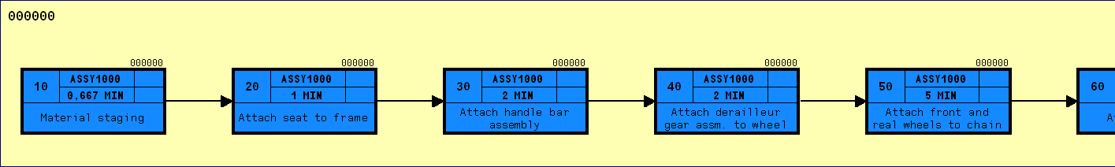
Routing
Routings enable you to plan the production of materials (products).
Routings are used as a template for production orders and run schedules
Routing are also used as a basis for product costing.
Series of sequential steps (operations) that must be carried out to produce a given product
Routings contain:
What, Where, When, How
Notes:
Routings enable you to plan the production of materials (products). Therefore, routings are used as a template for production orders and run schedules as well as a basis for product costing.
A routing is a description of which operations (process steps) have to be carried out and in which order to produce a material (product). As well as information about the operations and the order in which they are carried out, a routing also contains details about the work centers at which they are carried out as well as about the required production resources and tools (includes jigs and fixtures). Standard values for the execution of individual operations are also saved in routings.
In a routing you plan
- The operations (work steps) to be carried out during production
- The activities to be performed in the operations as a basis for determining dates, capacity requirements, and costs
- The use of materials during production
- The use of work centers
- The quality checks to be carried out during production

Slide 13

Routing
Routing – Operation 20
Attach seat to frame
Work Center – ASSY1000
Assembly Work Center
Time
1 minute

Slide 14
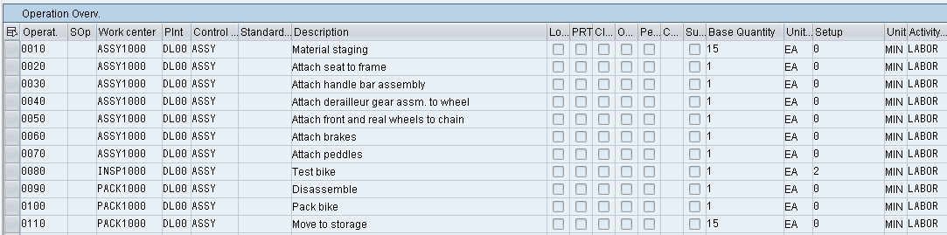
Routing
Routing for Finished Bike
Operation
Plant
Description
Activity Type
Work Center
Control Key
Time and Unit of Measure

Slide 15
Work Center
A location within a plant where value-added work (operations or activities) are performed
Work Centers can represent
People or Groups of People
Machines or Groups of Machines
Assembly Lines
Work center used to define capacities
Labor
Machine
Output
Emissions
Capacities used in
Capacity requirements planning (CRP)
Detailed scheduling
Costing
Notes:
Operations are carried out at a work center. In the SAP system work centers are business objects that can represent the following real work centers, for example:
- Machines, machine groups
- Production lines
- Assembly work centers
- Employees, groups of employees
Use
Together with bills of material and routings, work centers belong to the most important master data in the production planning and control system. Work centers are used in task list operations and work orders. Task lists are for example routings, maintenance task lists, inspection plans and standard networks. Work orders are created for production, quality assurance, plant maintenance and for the Project System as networks.

Slide 16
Work Center
Work centers capture and use the following Resource Related data
Basic Data
Person Responsible, Location of Work Center
Scheduling Information
Queues and Move Times (interoperation), Formula Keys
Costing Data
Cost Center, Activity Types
Personnel Data
People, Positions, Qualifications
Capacity Planning
Available Capacity, Formulas, Operating Time
Default Data
Control Key, Standard Text Key
Notes:
Data in work centers is used for
- Scheduling - Operating times and formulas are entered in the work center, so that the duration of an operation can be calculated.
- Costing - Formulas are entered in the work center, so that the costs of an operation can be calculated. A work center is also assigned to a cost center.
- Capacity planning - The available capacity and formulas for calculating capacity requirements are entered in the work center.
- Simplifying operation maintenance - Various default values for operations can be entered in the work center

Slide 17
Product Group
Aggregate planning that group together materials or other product groups (Product Families)
Multi- or Single- Level Product Groups
The lowest level must always consist of materials
Notes:
Aggregate forecasts of a group of similar products are generally more accurate than individual forecasts of the individual products that make up the group.

Slide 18
Material Planning
SOP provides a method for Sales Planning, Production Planning, Feasibility
Notes:
Reyovac Batteries
Constant Production building up On-hand inventory
90% of battery sales are in Nov and Dec for christmas

Slide 19
Production Planning & Execution
SIS
Forecasting
CO/PA
Sales & Operations Planning
Strategic Planning
Demand Management
MPS
Detailed Planning
MRP
Manufacturing Execution
Procurement Process
Order Settlement
Manufacturing Execution

Slide 20
Production Planning & Execution
Players in the Game
Strategic Planning
CEO, COO, CIO, CFO, Controller, Marketing Director
Detailed Planning
Line Managers, Production Scheduler, MRP Controller, Capacity Planners
Execution
Line Workers, Shop Floor Supervisors
SIS
Forecasting
CO/PA
Sales & Operations Planning
Strategic Planning
Demand Management
MPS
Detailed Planning
MRP
Manufacturing Execution
Procurement Process
Order Settlement
Manufacturing Execution

Slide 21
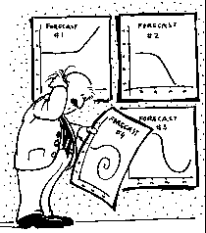
Forecasting
Forecasting is the foundation of a reliable SOP
Accurate forecasts are essential in the manufacturing sector
Overstocked & understocked warehouses result in the same thing: a loss in profits.
Notes:
Supply chain planning, to a large degree, starts with forecasting. Matching supply and demand is an important goal for most firms and is at the heart of operational planning. It is also of significant importance as the overly optimistic Cisco found in 2001 when it took a $2.2 Billion inventory write-down because of their ability to “forecast demand with near-scientific precision” 1. Since most production systems can’t respond to consumer demand instantaneously, some estimate, or forecast, of future demand is required so that the efficient and effective operational plans can be made.
Forecasts are always wrong, but some are “more wrong” than others. Forecasting the demand for innovative products, fashion goods, and the like is generally more difficult than forecasting demand for more “commodity-like” products that are sold on a daily basis. Aggregate forecasts of a group of similar products are generally more accurate than individual forecasts of the individual products that make up the group. Finally, the longer the forecast into the future, the less reliable the forecast will be.

Slide 22
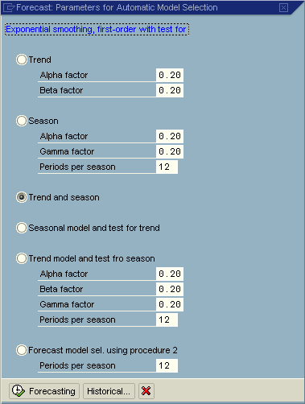
Forecasting
Forecasting Models
Trend
Seasonal
Trend and Seasonal
Constant
Selecting a Model
Automatically
Manually

Slide 23
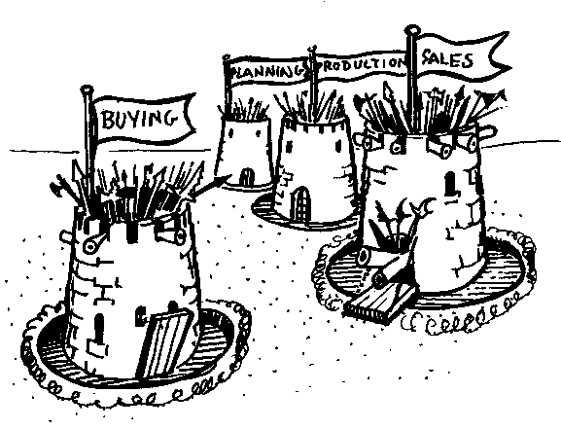
Sales and Operations Planning (SOP)
Information Origination
Sales
Marketing
Manufacturing
Accounting
Human Resources
Purchasing
Intra-firm Collaboration
Institutional Common Sense
Notes:
A more recent proposal to fix forecast errors is to use collaboration. The idea is that if different parts of the supply chain collaborate on a common forecast and everyone plans based on that single forecast; then there is little need for one part of the chain to hedge based on the uncertainty of what is done in other parts of the chain. Intra-firm collaboration, you would think, would be common place – seems that a little common sense would dictate that everyone in a firm come together with a common set of forecast figures. But this is rarely the case. Marketing has a set of forecasts, so too does operations. Sales has their forecast and it’s possible that for budgeting purposes Finance uses still another. The advancement of enterprise resource planning (ERP) systems is helping ensure that there is only one forecast, based upon the principles of a single data repository used by all areas of the enterprise.
Forecasts affect most functional areas of the firm and are the starting point for resource allocation decisions. For example, manufacturing must plan production on a day to day basis to meet customer orders, while purchasing needs to know how to align supplier deliveries with the production schedules. Finance needs to understand the forecasts so that the proper levels of investment can be made in plant, equipment, and inventory and so that budgets can be constructed to better manage the business. The marketing function needs to know how to allocate resources for various product groups and marketing campaigns. Forecasts also determine the labor requirements required by the firm so that the human resources function can make proper hiring and training decisions when demand is expected to grow.

Slide 24
Sales and Operations Planning (SOP)
Flexible forecasting and planning tool
Usually consists of three steps:
Sales Plan
Production Plan
Rough Cut Capacity Plan
Planned at an aggregate level in time buckets

Slide 25
Demand Management
Link between Strategic Planning (SOP) & Detailed Planning (MPS/MRP)
The results of Demand Mgmt is called the Demand Program, it is generated from our independent requirements - PIR and CIR
Notes:
Aggregating forecasts across multiple items reduces forecasting errors. A clothing store, for instance, might be able to estimate within a pretty narrow range what the demand will be for men’s dress shirts. But when that store tries to estimate the demand for individual styles, colors, and sizes of shirts, the accuracy of their forecasts will be considerably worse. Firms handle this kind of forecasting problem usually in one of three ways; they either forecast from the bottom up, from the top down, or they start in the middle and work both up and down. The “top down” forecast essentially estimates total sales demand and then divides those sales dollars level by level until the stock keeping unit (SKU) is reached. The “bottom up” method, as one might expect, starts with forecasts at the SKU level and then aggregates those demand estimates level by level to reach a company–level forecast. Another method, one might call the “in-between” method, starts forecasts at the category level (like men’s dress shirts), and then works up to determine store sales and works down to divide up the forecast into styles, colors and SKUs.

Slide 26
Demand Management
Forecast
Sales
Planned
Independent
Requirements
Customer
Independent
Requirements
Demand
Program
MPS / MRP

Slide 27
Planning Strategies
Planning strategies represent the business procedures for
The planning of production quantities
Dates
Wide range of strategies
Multiple types of planning strategies based upon environment
Make-To-Stock (MTS)
Make-To-order (MTO)
Driven by sales orders
Configurable materials
Mass customization of one
Assembly orders
Notes:
Planning strategies represent the business procedures for the planning of production quantities and dates. A wide range of production planning strategies are available in the SAP R/3 System, offering a large number of different options ranging from pure make-to-order production to make-to-stock production. Depending on the strategy you choose, you can:
Use sales orders and/or sales forecast values to create the demand program
Move the stocking level down to the assembly level so that final assembly is triggered by the incoming sales order
Carry out Demand Management specifically for the assembly
Strategies for Make-to-Stock Production
Purpose
The planning strategies explained in this section are designed for planning procurement (production or purchasing) of components by planning the final products. If you can plan at component level more easily.
Prerequisites
Choose a make-to-stock strategy, if:
The materials are not segregated. In other words, they are not assigned to specific sales orders.
Costs need to be tracked at material level, and not at sales order level.
Strategies for Planning Components
Purpose
The planning strategies explained in this section are designed for planning the procurement (production or purchasing) of components by planning the components themselves. This is particularly useful in the following cases:
There is a variety of finished products (possibly with an irregular demand pattern where planning is not possible).
The finished products are consumption-based.
The overall purpose of planning at component level is to procure components to stock (without sales orders) in order to react to customer demand as quickly as possible.
Prerequisites
Choose a strategy for planning components, if:
The components are not segregated; that is, they are not uniquely linked at specific orders.
Costs should be tracked at component (material) level and not at order level.

Slide 28
Planning Strategy for Make-to-Stock
Planning takes place using Independent Requirements
Sales are covered by make-to-stock inventory
Strategies
10 – Net Requirements Planning
11 – Gross Requirements Planning
30 – Production by Lot Size
40 – Planning with Final Assembly
Notes:
Strategies for Make-to-Order (MTO) Production
Purpose
The planning strategies explained in this section are designed for the production of a material for a specific individual sales order. In other words, you do not want to produce finished products until you receive a sales order. This means that make-to-order strategies always support a very close customer-vendor relationship, because your sales orders are closely linked to production.
The same relationship exists between the sales order and production that exists in a make-to-order environment. Make-to-order is also used in the following environments.
Production using variant configuration
Assemble-to-order
Prerequisites
Choose a make-to-order strategy, if:
The materials are segregated. In other words, they are uniquely assigned to specific sales orders.
Costs must be tracked at sales order level and not on material level.
Strategies for Configurable Materials
Definition
A configurable material is a material for which different variants are possible.
The strategies for configurable materials allow you to plan products with an almost unlimited number of possible combinations of characteristics and combination value keys. Use these strategies if you want to plan a product that uses a feasible combination of characteristic values and that does not include final assembly. Typical examples of such products are cars, elevators, forklifts, trucks, buses.
Assemble-to-order
An assemble-to-order environment is one in which the product or service is assembled on receipt of the sales order. Key components are planned or stocked in anticipation of the sales order. Receipt of the order initiates assembly of the customized product. Assemble-to-order is useful where a large number of finished products can be assembled from common components.

Slide 29
Planning Strategy for Make-to-Order
Planning takes place using Customer Orders
Sales are covered by make-to-order production
Strategies
20 – Make to Order Production
50 – Planning without Final Assembly
60 – Planning with Planning Material

Slide 30
Master Production Scheduling (MPS)
MPS allows a company to distinguish planning methods between materials that have a strong influence on profit or use critical resources and those that do not
Notes:
Using MPS you can carefully plan important parts or bottleneck parts in a separate planning run
at the highest BOM level before the planning results have an effect on all of the production levels.

Slide 31
Material Requirement Planning (MRP)
In MRP, the system calculates the net requirements while considering available warehouse stock and scheduled receipts from purchasing and production
During MRP, all levels of the bill of material are planned
The output of MRP is a detailed production and/or purchasing plan
Detailed planning level
Primary Functions
Monitor inventory stocks
Determine material needs
Quantity
Timing
Generate purchase or production orders
Notes:
The central role of MRP is to monitor stocks and in particular, to automatically create procurement proposals for purchasing and production (planned orders, purchase requisitions or delivery schedules). This target is achieved by using various materials planning methods which each cover different procedures.
Consumption-based planning is based on past consumption values and uses the forecast or other statistical procedures to determine future requirements. The procedures in consumption-based planning do not refer to the master production schedule. That is, the net requirements calculation is not triggered either by planned independent requirements or dependent requirement. Instead, it is triggered when stock levels fall below a predefined reorder point or by forecast requirements calculated using past consumption values.

Slide 32
Demand-Independent vs. Dependent
Independent Demand – Original source of the demand.
Dependent Demand – Source of demand resides at another level.

Slide 33
Material Requirement Planning (MRP)
MRP is used to ensure the availability of materials based on the need generated by MPS or the Demand Program
5 Logical Steps
Net Requirements Calculation
Lot Size Calculation
Procurement Type
Scheduling
BOM Explosion

Slide 34
Net Requirements
Procurement
Proposal
Requirements –
Planned Ind. Req.,
Reservations
Sales Orders,
Etc.
Shortage
Firmed Receipts
Firmed Orders
or Purchase
Requisitions
Stock
Safety Stock

Slide 35
Lot sizing
Static
Based on fixed values in the Material Master
Periodic
Groups net requirements together from multiple periods
Optimum
Calculates the optimum lot size for a several periods of net requirements
Notes:
The lot-size calculation is carried out in MRP. In the net requirements calculation, the system determines material shortages for each requirement date. These shortage quantities must be covered by receipt elements. The system then calculates the quantities required for the receipts in the planning run in the procurement quantity calculation.
In static lot-sizing procedures, the procurement quantity is calculated exclusively by means of the quantity specifications entered in the material master.
Features
The following static lot-sizing procedures are available:
Lot-for-lot order quantity
Fixed lot size
Fixed lot size with splitting and overlapping
Replenishment up to maximum stock level
In period lot-sizing procedures, the system groups several requirements within a time interval together to form a lot.
Features
You can define the following periods:
days
weeks
months
periods of flexible length equal to posting periods
freely definable periods according to a planning calendar
The system can interpret the period start of the planning calendar as the availability date or as the delivery date.
In static and period lot-sizing procedures, the costs resulting from stock keeping, from the setup procedures or from purchasing are not taken into consideration. The aim of optimum lot-sizing procedures, on the other hand, is to group shortages together in such a way that costs are minimized. These costs include lot size independent costs (setup or order costs) and storage costs.

Slide 36
Procurement Type
External Procurement
Purchase Requisition
Purchase Order
Schedule Line
Internal Procurement
Planned Order
Production Order
Process Order

Slide 37
Multi-Level Scheduling
Requirements
Date
Planned Order
Purchase Requisition
Finished Product
Assembly 1
Semi-Finished Good
Raw Material
Component
Time

Slide 38
MRP vs. Consumption-Based
Whether or not a material is planned using MRP or Consumption Based is determined by the MRP Type on the MRP1 screen of the Material Master
MRP
Consumption Based
PD – MRP
VB – Reorder-Point
VSD – Seasonal MRP
VV – Forecast Based
RP – Replenishment

Slide 39
Consumption-Based
Lot Size
Reorder Point
Safety Stock
Replenishment Lead Time

Slide 40
Output of MRP
MRP
In-House
Production
Planned Order
External
Procurement
Convert to
Production
Orders
Purchase
Requisitions
Process
Orders
Purchase
Orders
Schedule
Lines

Slide 41
Orders, orders, orders
Planned Order (planning)
A request created in the planning run for a material in the future (converts to either a production or purchase order)
Production Order (execution)
A request or instruction internally to produce a specific product at a specific time
Purchase Order (execution)
A request or instruction to a vendor for a material or service at a specific time
Notes:
A request or instruction from a purchasing organization to a vendor (external supplier) or a plant to deliver a quantity of material or to perform services at a certain point in time.

Slide 42
Manufacturing Execution Process
Capacity
Planning
Production
Proposal
(Planning/Other)
Schedule
and Release
Shop Floor
Documents
Order Settlement
Goods
Issue
Goods
Receipt
Completion
Confirmation

Slide 43
Production Order
Production orders are used to control production operations and associated costs
Production Orders define the following
Material produced
Quantity
Location
Time line
Work involved
Resources used
How to costs are settled

Slide 44
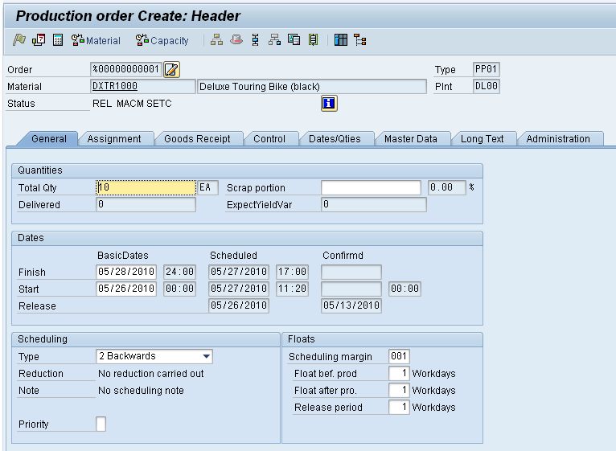
Production Order
How
Components
What
How many
Time Line

Slide 45
Schedule
Calculates the production dates and capacity requirements for all operations within an order
Determines a Routing
Operation specific time lines
Material Consumption Points
Material Master
Scheduling Margin Key (Floats)
Work Center
Formulas
Standard Inter-operation Times

Slide 46
Release
Two release processes
Header Level
Entire order and all operations are released for processing, order is given a REL status
Operation Level
Individual operations within an order are released
Order is given a PREL status
Not until the last operation is released does the order obtains a REL status
Automatic vs. manual

Slide 47
Availability Check
Automatic check to determine whether the component, production resource tools, or capacities in an order are available
Can be automatic or manually executed
Determines availability on the required date
Generates an availability log
Displays results of the check
Missing parts list
Reservations that could not be verified

Slide 48
Schedule & Release
The time between scheduling and releasing an order is used for company checks and any preparation needed for the processing of the order
Once an order has been released it is ready for execution, we can at this time
Print shop floor documents
Execute goods movements
Accept confirmations against the order

Slide 49
Shop Floor Documents
Shop Floor Documents are printed upon release of the Production Order, examples would be:
Operation-based Lists
Time Tickets, Confirmation Slips
Component-based Lists
Material Withdrawal Slips, Pull List (consumption list)
PRT Lists
Overview of PRT’s used and in which operations
Multi-Purpose Lists
Operation Control Ticket, Object Overview
Notes:
List Types
The SAP system differentiates between the following types of lists:
Operation-based lists, for example, time tickets, confirmation slips
Component-based lists, for example Pull List, material withdrawal slips
PRT lists, for example, PRT overview
Multi-purpose lists, for example, object overview, operation control ticket
This type of list can contain information about operations or production resources and tools, for example.
The lists that the system generates and prints refer to all operations, suboperations, components, and production tool and resources contained in a production order.

Slide 50
Material Withdrawal
When a production order is created it references a BOM to determine the necessary components to produce the material.
It then places a reservation on each of the components.
Upon release of the order (or operation) you can withdraw the reserved materials from inventory
Reservation is updated
Inventory is updated
Costs are assigned to the order as actual costs
Notes:
You can withdraw materials for an order that are not listed as components in the order. These "unplanned withdrawals" cause the actual costs of the production order to be updated.

Slide 51
Confirmations
Confirmations are used to monitor and track the progression of an order through its production cycle
Confirmation can be done at the operation or order level
Exact confirmation shortly after completion of an operation is essential for realistic production planning and control
Data that needs confirmation include
Quantities – yield, scrap, rework
Activity data – setup time, machine time
Dates – setup, processing, teardown started or finished
Personnel data – employee who carried out the operation, number of employee involved in the operation
Work center
Goods movements – planned and unplanned
Variance reasons
PRT usage

Slide 52
Goods Receipt
Acceptance of the confirmed quantity of output from the production order into stock
Effects of the Goods Receipt
Updates stock quantity
Updates stock value
Price stored for future valuation changes
Production order is updated
Three documents are created
Material document
Accounting document
Controlling document

Slide 53
Order Settlement
Consists of settling the actual costs incurred in the order to one or more receiver cost objects
Receivers could include: a material, a cost center, an internal order, a sales order, a project, a network, a fixed asset
Parameters for Order Settlement
Settlement Profile
Specifics the receivers, distributions rules and method
Settlement Structure
Determines how the debit cost elements are assigned to the settlement cost elements
Settlement Rule
Automatically assigned on creation of order, the parameters are used to define this rule
Has one or more distribution rules assigned to it
Distribution rules defines: cost receiver, settlement share, settlement type

Slide 54
Order Settlement
Settling a Production Order to Stock
Debt posting is made to the Production Order with the value of the material
Difference between the debt posting and credit posting is posted to a price difference account
Material
Prod. Order
Price Diff.
80
100
20
* Material Price is determine by the quantity produced times the Standard Price in the Material Master.
Notes:
Since production costs were higher than planned, the additional expenditure negatively affects the operating profit. This means that the profit decreases by the amount by which the actual costs charged to the production order exceed the standard price.
The actual costs charged to the production order affect net income just as the posting of the inventory change at the time of the goods receipt. Since the actual expense was 20 higher than expected, the operating profit is 200 lower than it would have been if production had been at standard cost.

Slide 55
Order Settlement
Costs analyzed
Primary
Materials
External Processing
Secondary
Production, Material, and Administrative Overhead
Labor
Cost Analysis Reporting
Calculate and analyze planned costs, target costs, and actual costs of the production order.
Calculate and analyze variances
Notes:
Calculate and analyze planned costs, target costs, and actual costs of production orders and process orders
Calculate or update the work-in-process inventory and the finished goods inventory
Calculate and analyze variances
Transfer data to Financial Accounting (FI)
Transfer data to Profitability Analysis (CO-PA)
Transfer data to Profit Center Accounting (EC-PCA)
Transfer data to Actual Costing / Material Ledger (CO-PC-ACT)

Slide 56
Question and Answer Session
Q & A

Slide 57
What we will cover next
Financial Accounting

